Slide 1
FOOD DELIVERY APPLICATION CAPSTONE PROJECT
Prepared By
Ashim Aakash Roy
Ashutosh Kumar

Slide 2





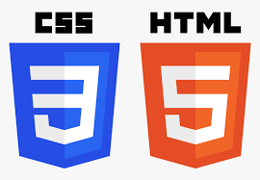






TECHNOLOGIES IMPLEMENTED
FRONT-END
BACK-END
MISCELLANEOUS

Slide 3
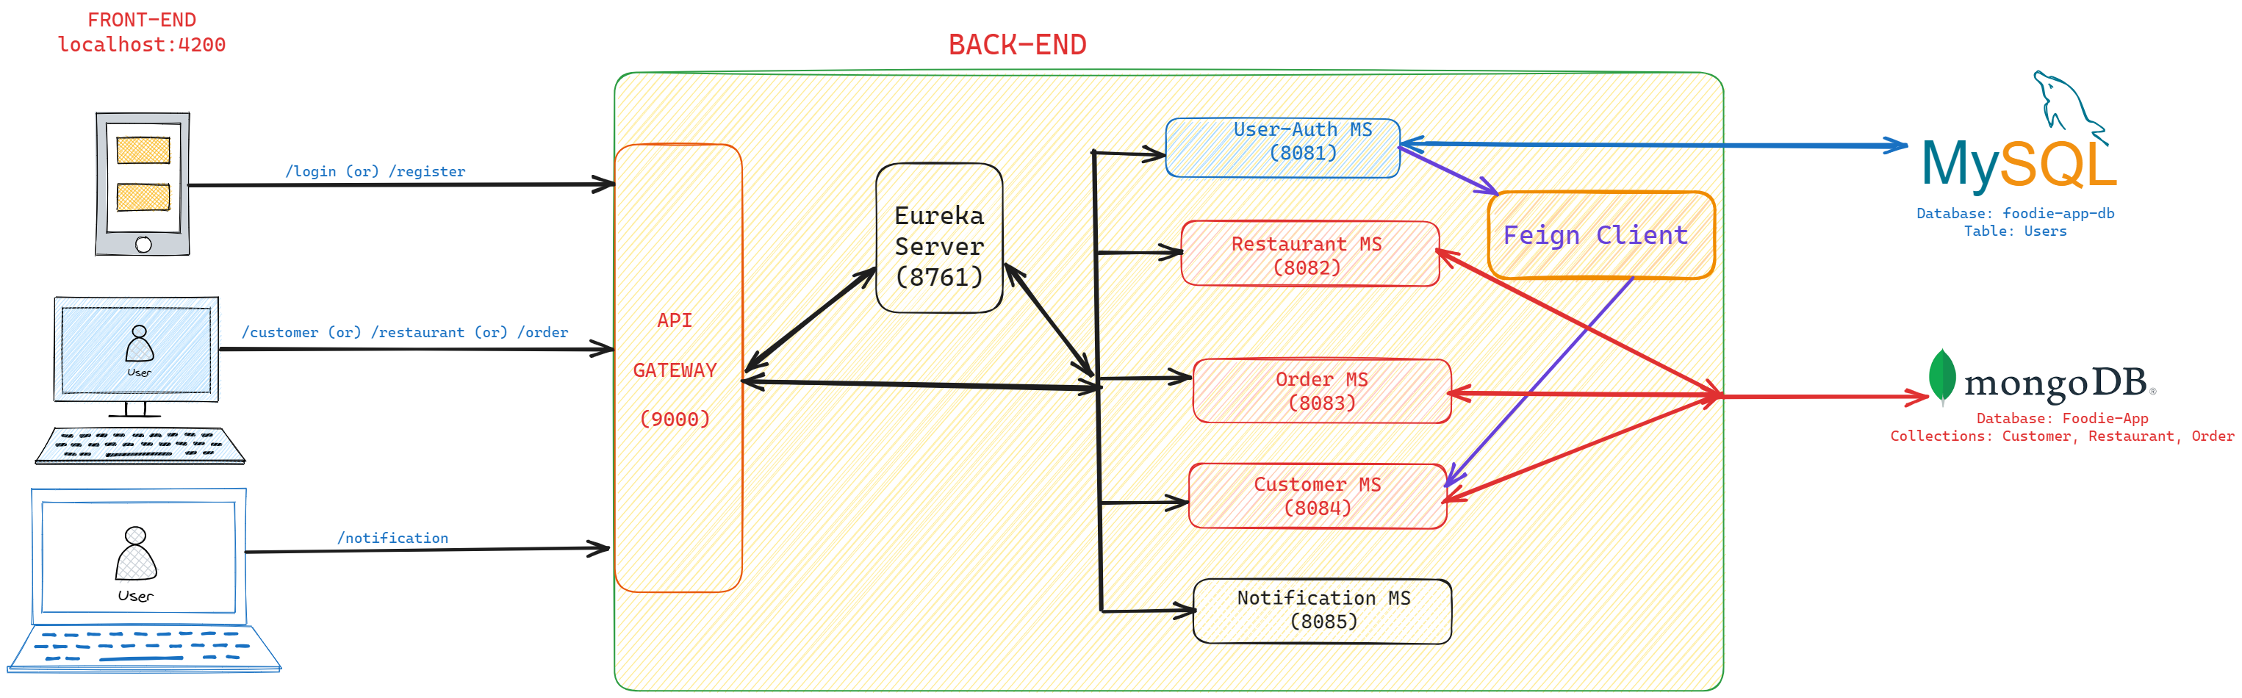
ARCHITECTURE DIAGRAM

Slide 4
BACK-END MODULE
Implements Spring Boot as the web based framework of JAVA
Follows Micro-service based architecture
Micro-services included in Backend module:
1. Customer Auth (Port# 8081)
2. Customer Service (Port# 8082)
3. Restaurant Service (Port# 8083)
4. Order Service (Port# 8084)
5. Eureka Server (Port# 8761)
6. API Gateway (Port# 9000)

Slide 5
IMPORTANT FILES
Dockerfile: It is a document containing all the commands the user requires to call on the command line to assemble an image
application.yml: It is primarily used to modify configuration parameters, such as connectivity with database, port number, eureka registry etc.
pom.xml: It is used to keep a track of project details such as group ID, artifact ID, and also all the list of dependencies required
compose.yaml: It is used to run multi-container docker application.

Slide 6
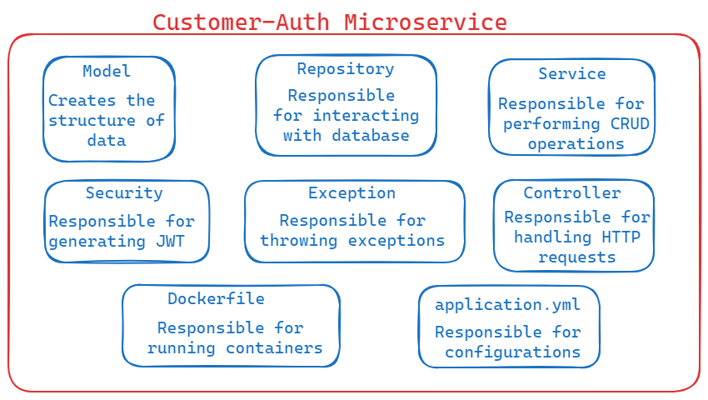
CUSTOMER AUTH
Purpose:
Allows new Users to register
Allows registered user to login
Generates a JSON Web Token (JWT), whenever a registered user logs in
Customer Details are stored in MySQL Database

Slide 7
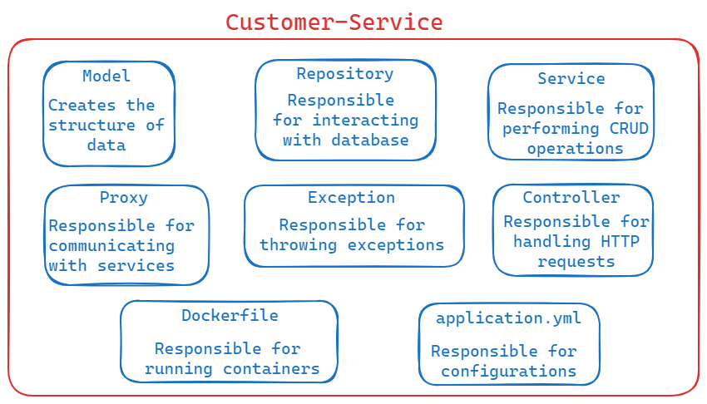
CUSTOMER SERVICE
Purpose:
Fetch customer by email or list of all customers
Update or delete customer by email
Add restaurant or view one or all restaurant for customer
Customer details are stored in Mongo DB database

Slide 8
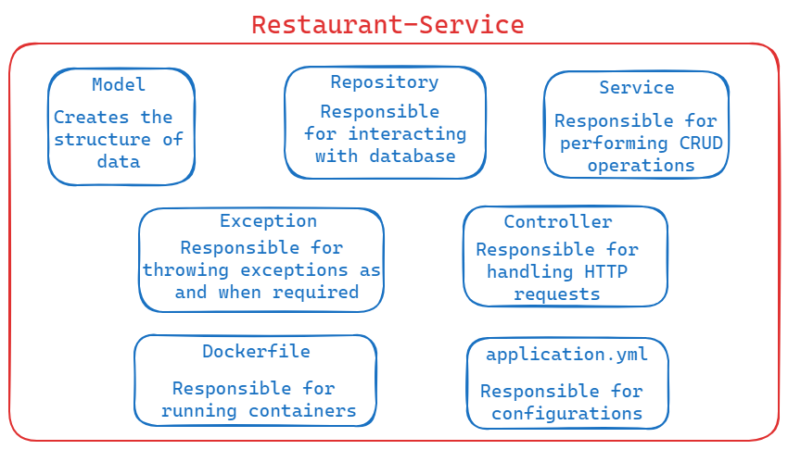
RESTAURANT SERVICE
Purpose:
Add a Restaurant
Get one or List of all restaurants
Update or delete all restaurants
Restaurant details are stored in Mongo DB database

Slide 9
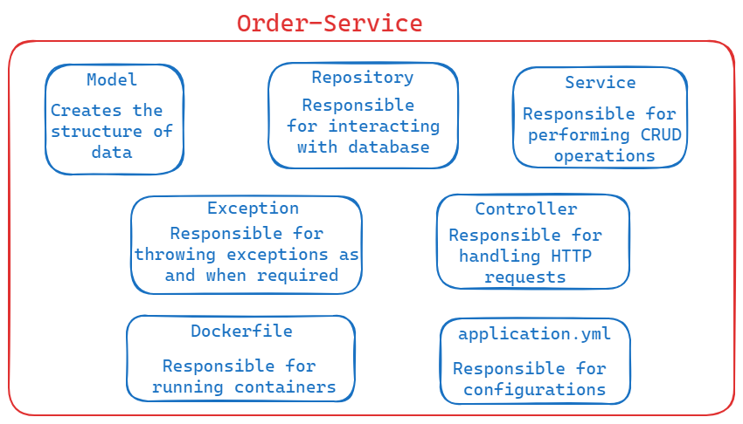
ORDER SERVICE
Purpose:
Add an order
Find one order or list of order based on required criteria
Update or remove any order by ID for a customer
Add or Update delivery address
Fetch one or list of addresses for a customer
Order details are stored in Mongo DB database

Slide 10
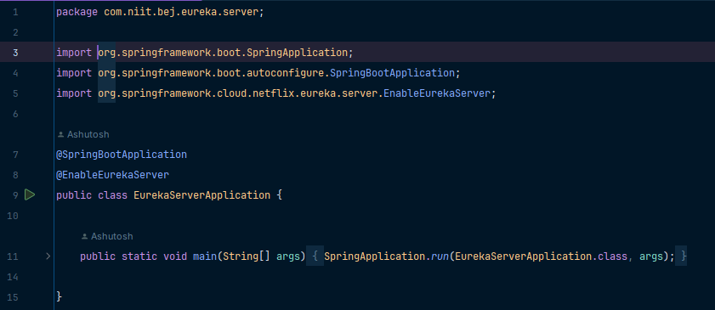
EUREKA SERVER
Purpose:
Does not register itself as a micro-service
Rather, works as service discovery
In simpler terms, keeps a track of all micro-services present in the backend module.
The annotation @EnableEurekaServer is implemented.

Slide 11
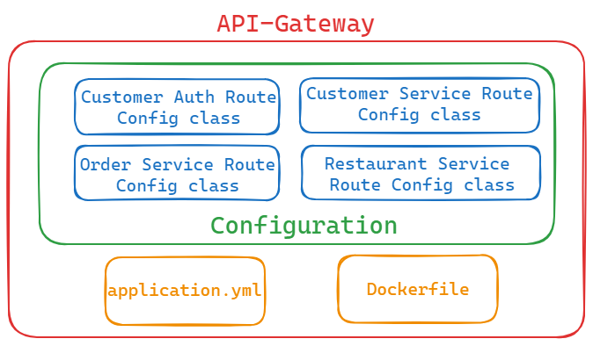
API GATEWAY
Purpose:
All requests pass through API Gateway
Provide a common port number for handling all requests
Configures the routes of all the micro services

Slide 12
FRONT-END MODULE
Developed by using Angular, a free web based JS framework
Angular is primarily used to develop Single Page Applications (SPA)
WHY ANGULAR ?
1. Custom Components
2. Dependency Injection (DI)
3. Device Compatibility & Seamless User Experience

Slide 13
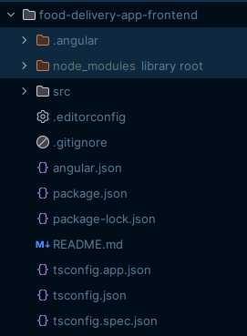
IMPORTANT FILES
angular.json: Stores information about the architecture, dependencies, build and test configurations
package.json: It is a file that contains information about the project and its dependencies
tsconfig.json: It specifies the base Typescript and Angular compiler options
app.module.ts: Maintains a track of all components and imports, required in the project
app-routing.module.ts: Specifies what component to be loaded, when a specific path is entered

Slide 14
Components & SERVICES
Register & Login
Header, Footer & Search
Homepage
Menupage
Cart-page
Food
Restaurant
Cart

Slide 15
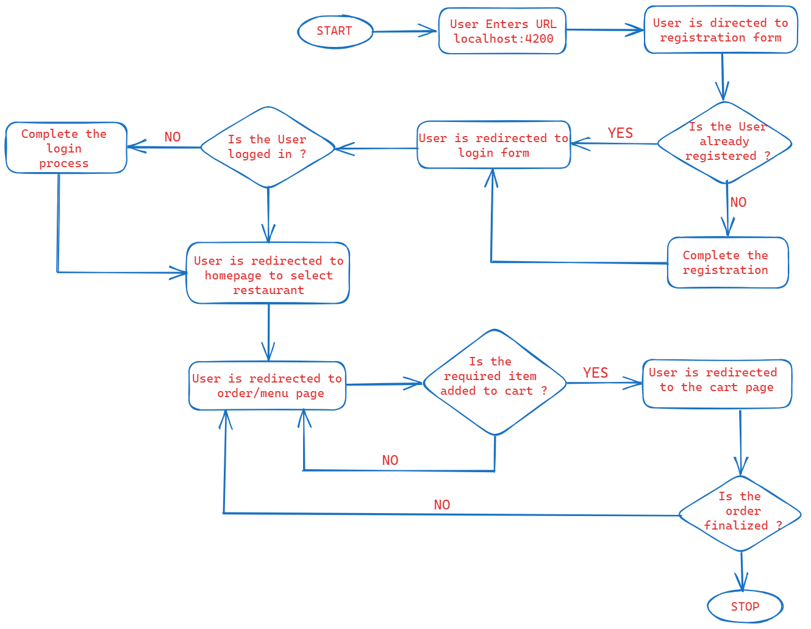
PROJECT FLOWCHART

Slide 16
FUTURE SCOPE…
Payment Interface, by using Payment Gateway
Live Order tracking, by adding Google Maps
Search functionality to filter menu, based on item name or category

Slide 17
System.out.println(“Thank You”);

